Slide 1
Examining clusters of Chicago restaurants by Zip Code, population and income
Capstone Project
IBM Data Science Professional Certification
Jim Kaczkowski
June, 2020

Slide 2
Introduction/ Business Problem
With the advent of the Covid-19 pandemic, restaurants face increasing challenges with business closures, employee lay-offs and, upon re-opening, maintaining profitability
One hypothesis for successful restaurants in a post-Covid-19 world is that they will need to find more customers with more income
This analysis will examine whether restaurant cluster data from Fousquare, combined with income and population data by zip code can define new opportunities for opening restaurants by existing restaurateurs and new restaurant investors.

Slide 3
Data
This analysis will use the Foursquare Places API as well as publicly available data to rank Chicago zip codes by population density, average income, and the number of competing restaurants. The following data sets will be used:
US Zip Codes with Latitude and Longitude This national data set supplies zip codes with geospatial coordinates. Latitude and Longitude from Chicago zip codes, beginning with "606", will be extracted to form the foundation of later API calls, using Foursquare.
Population by US Zip Code This is a Kaggle data set that shows population by zip code, as of 2010.
Income by US Zip Code This is a large data set from the IRS, from which median income by zip code can be extracted.
The Foursquare Places API Foursquare data will be used to specify the number of restaurant venues by zip code.

Slide 4
Methodology
The approach will be to develop stratified maps showing Chicago zip codes, separated into tiers, based on population density and median income.
Foursquare venue data will then be overlaid to show clustering of venues by zip code.
This analysis will then aim to enhance any clustering by examining primarily food venues while excluding businesses such as facial salons and yoga studios.
Lastly the analysis will incorporate income and population by zip code to test whether more well defined clusters emerge.

Slide 5
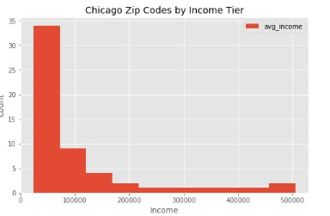
Results -- Income
Average Individual Income is highly skewed toward the central downtown area of Chicago (two zip codes). Income in 2 zip codes is roughly five times that of 34 other zip codes in the city

Slide 6
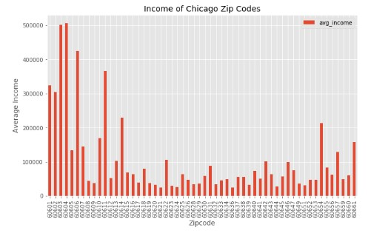
Results -- Income
Average Individual Income is highly skewed toward the central downtown area of Chicago (two zip codes). Income in 2 zip codes is roughly five times that of 34 other zip codes in the city

Slide 7
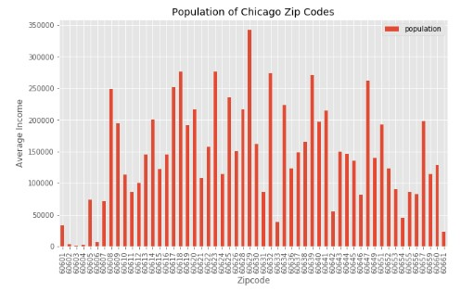
Results -- Population
Population, on the other hand, is highly skewed away from the city center of Chicago (the three zip codes on the left of the histogram).

Slide 8
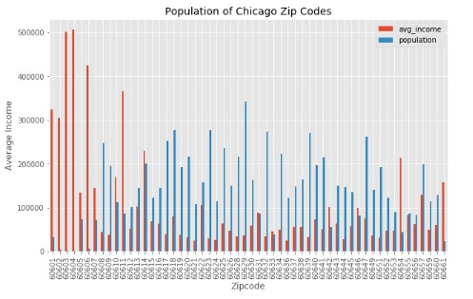
Results – Population & Income
A histogram of both income and population shows the least populated zip codes in the city center have significantly higher income.

Slide 9
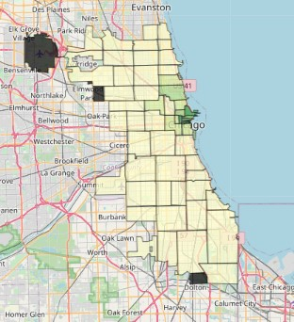
Income by Zip Code

Slide 10
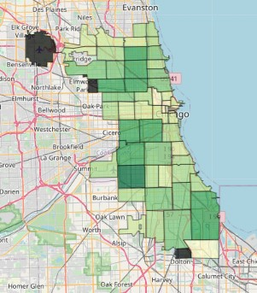
Population by Zip Code

Slide 11
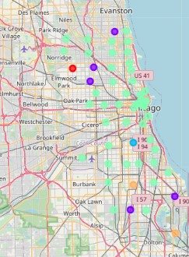
Venue Clusters in Chicago
Foursquare data was downloaded for each and clustered using K-Means clustering. The clusters were visualized via a folium map

Slide 12
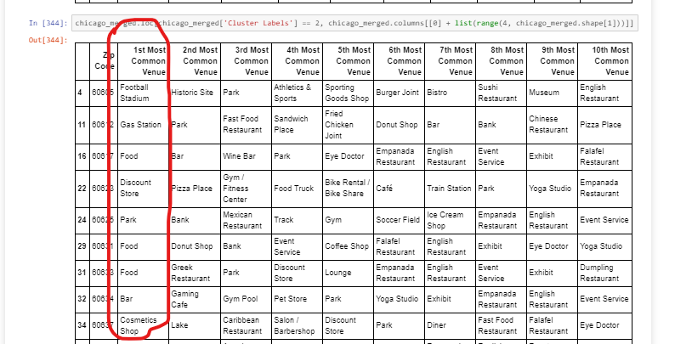
Challenges with Foursquare Date
One of the challenges of the venue clustering may have been the inclusion of numerous non-food venues in the Foursquare results.

Slide 13
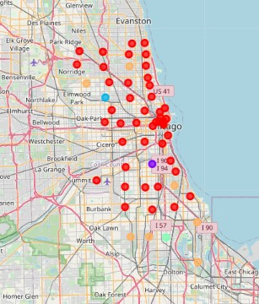
“Mostly Food” Venue Clusters in Chicago
In order to refine the analysis, non-food venues were removed from the Foursquare results to determine if clustering was more defined. K-Means clustering was then used. The results do not appear to have improved the definition of the clusters.

Slide 14
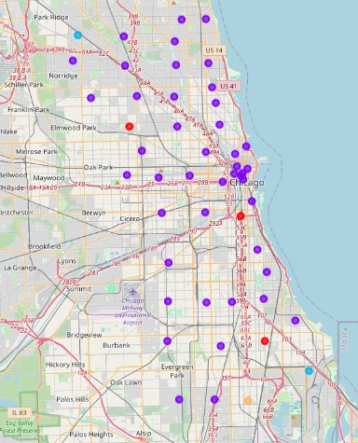
“Mostly Food” Venues with Population and Income Data
A third component was then the addition of population and income data to the Foursquare venue data by zip code. Due to the large ranges of both income and population, those variables were normalized, using MinMax Scaling from the SkLearn library, so as not to skew the clustering.
Unfortunately, the addition of income and population data has not improved the segmentation across zip codes in Chicago neighborhoods. This may be explained by the relatively flat levels of income and population across across 34 out of the 56 Chicago Zip Codes.

Slide 15
Discussion
The objective for this analysis was to determine if population and income data provided more granularity into clustering of food venues in Chicago. Based on available data, the answer is that population and income don’t improve the clustering of food venues in Chicago.
The general uniformity of population in the zip codes outside the city center provides little illumination on specific opportunities for new restaurant location.
The extreme high income of the two downtown zip codes appears to be offset by their sparse population. Elsewhere, income is generally uniform and thus provides little illumination on specific opportunities for new restaurant location.

Slide 16
Discussion
Additional data may help to improve this analysis, such as the following:
Data on commercial real estate costs by zip code to calculate potential return on investment for a new restaurant.
Data on automobile and pedestrian traffic by zip code to assess viability of drive-through and “take-out” opportunities for new establishments.
More detailed data on “restaurant type” and cuisine to assess more local opportunities for new establishments. (The Foursquare type information appears to consist of user supplied verbiage on restaurant type and thus leads to inconsistency of classification.)
It also must be considered if Zip Code is too large a designation to provide meaningful segmentation in a city like Chicago.

Slide 17
Conclusion
This analysis is a capstone project to demonstrate my mastery and use of skills taught in 8 previous courses in the IBM Data Science Professional Certification. In this analysis I have employed the following tools and techniques:
Jupyter Notebooks
Watson Data Studio
Downloading and scraping web data from various sources such as government data portals and Kaggle.
Data Hygiene and Clean up
Creating SQL databases and performing SQL queries
Manipulating JSON and GeoJSON files for both data analysis and geo-spatial data visualization
Downloading venue and location data via API calls from the Foursquare database
Use of Folium and MatPlotLib for data visualization, namely:
Histograms
Choropleth maps
Geo-location maps
Use of K-Means Clustering and data normalization
Sharing of work via the Github community
This project and this course sequence have provided me with the basic understanding of the tools of Data Science so that I can develop my skills further with more complex data. The skills and opportunities that I have acquired in this course sequence have ignited a curiosity for me to explore more complex analytical techniques and more complex data sets. I truly appreciate this first step in my journey to a career in Data Science.

